Slide 1
Volcanoes on Venus
Austin Pacharz
Thinkful Data Science Flex
Notebook: Google Colab Notebook

Slide 2
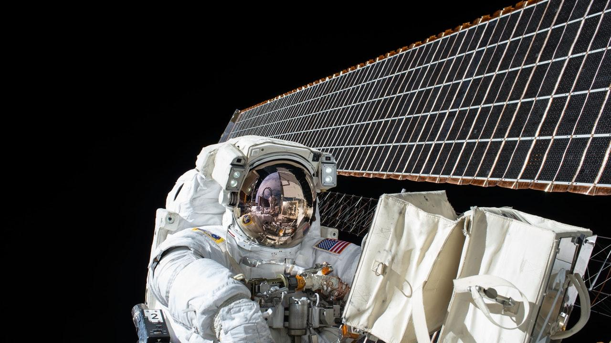
From Kaggle
[click here]

Slide 3
Volcanoes on Venus
Image data from Magellan spacecraft that arrived at Venus in 1990 that spotted volcanoes on the surface.
My personal interest stems from initially majoring in Astrophysics at CU Boulder before switching to Mathematics.

Slide 4

Volcanoes on Venus
Being able to predict where volcanoes are located could help map the surface of Venus and plan best landing locations for future missions.

Slide 5
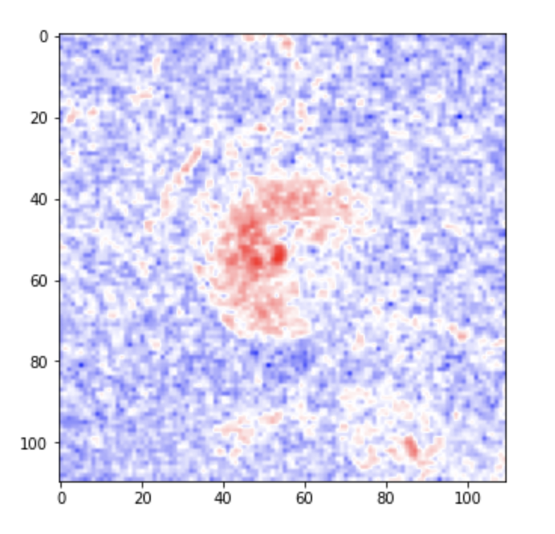
What’s in the Data?
Image CSV’s split into train and test
7000 images 110px by 110px
7000 by 12100 array

Slide 6
What’s in the Data?
Label CSV’s split into train and test
Volcano?:
If there are volcanoes (Main target)
For Volcano?=0 this three next features are NaN
Type:
1= definitely a volcano, 2 =probably, 3= possibly, 4= only a pit is visible
Radius (pixels)
Number Volcanoes

Slide 7
Data Distribution
Initial
About 28% in test data
About 14.23% labeled as Volcano
Re-split
20% in test data
Sampling techniques
None
Random undersampling
SMOTE oversampling

Slide 8
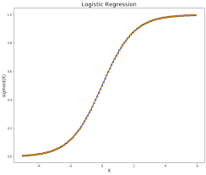

Models
Logistic Regression
Random Forest Classification

Slide 9
Model Selection
Comparing Models:
LR = Logistic Regression RF = Random Forest
Sampling | Model | Accuracy | Recall | Precision | F1
None | LR | 92.71% | 63.61% | 83.39% | 72.16%
 | RF | 92.63% | 45.95% | 92.63% | 61.43%
Random Undersampling | LR | 86.14% | 84.29% | 86.39% | 86.12%
 | RF | 88.24% | 85.64% | 91.14% | 88.13%
SMOTE | LR | 97.76% | 99.90% | 96.01% | 97.81%
 | RF | 98.85% | 99.32% | 98.52% | 98.85%

Slide 10
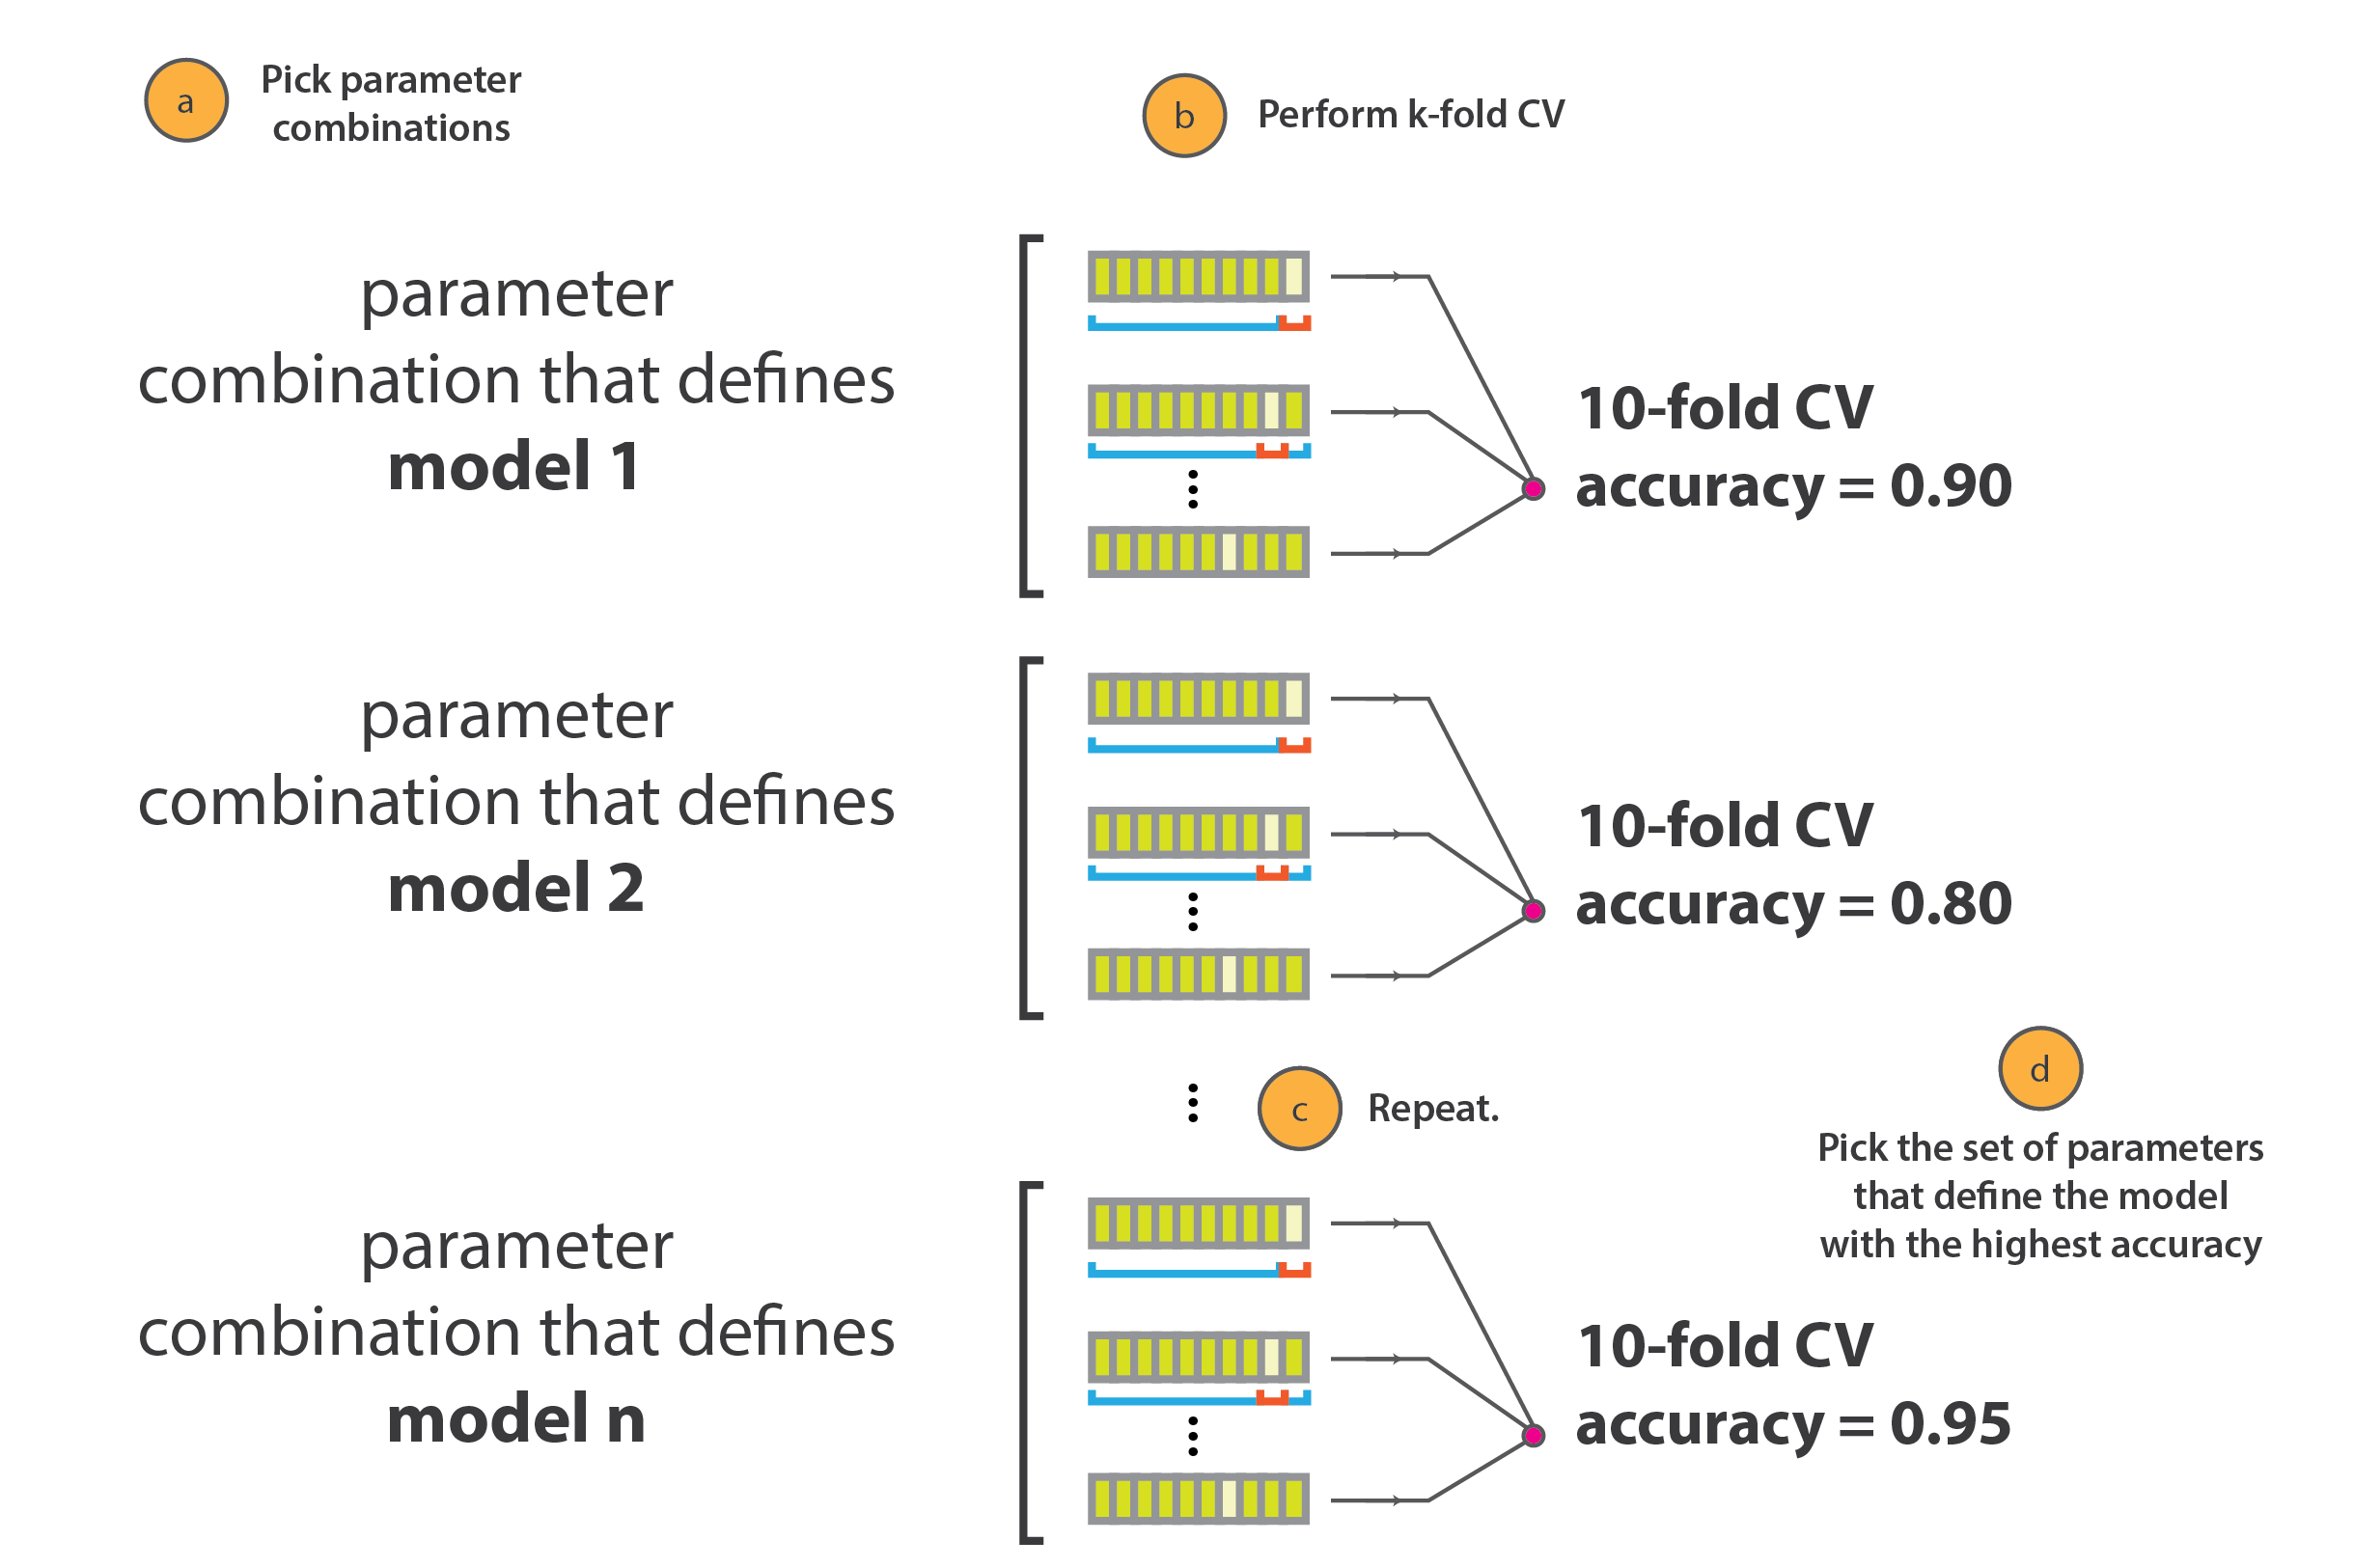
Model Tuning
This is how GridSearchCV searches for parameters using n-fold cross validation:

Slide 11
Model Tuning: Logistic Regression
Using GridSearchCV I was able to tune hyperparameters for Logistic Regression using Ridge Regularization.
It provided a C-value of 1000.0
The default C-value is 1.0
Model | Param | Accuracy | Recall | Precision | F1
Ridge | C=1000.0 | 97.93% | 100% | 96.09% | 97.97%
Ridge | C=1.0 | 97.76% | 99.90% | 96.01% | 97.81%

Slide 12
Takeaways

Slide 13
Next Steps
Continue tuning Logistic Regression and learning about regularization techniques
Try PCA to reduce dimensions to save runtime
Try other models
Look into predicting other labels
Come back to project after Deep Learning

